Slide 1
GRANTS 101: Finding & Funding Your Goals
Tiffany Isselhardt
Kentucky Museum @ WKU

Slide 2
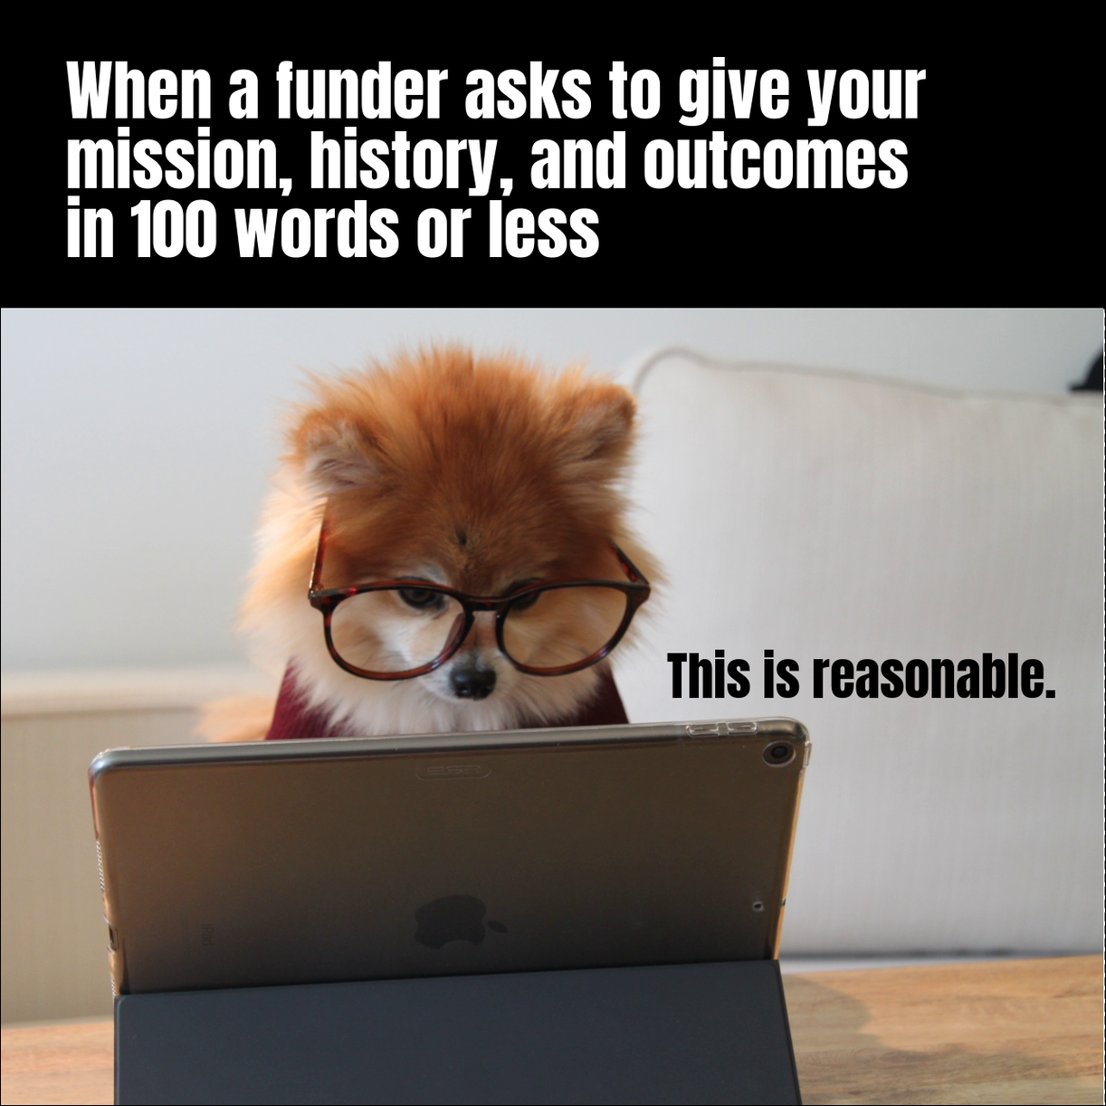
Meet the presenter
Tiffany is the Exhibits Curator and Development Coordinator for the Kentucky Museum at WKU.
In the past five years, she has secured 38 grants totaling $708,907.
During that time, she also revamped membership, sponsorship, crowdfunding, and publishing programs to more than double the museum’s annual revenue.
From August 2018 to May 2023, her ROI is 6.84, meaning she raised $6.84 for every $1 paid to her.

Slide 3
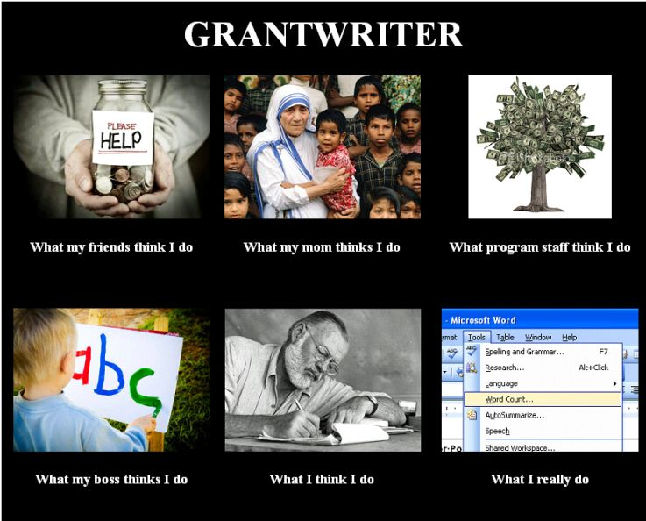
Agenda
What do you need? (Your Goals)
Finding Sources (Federal, State, Private)
Private Grants Process
Locating Private Funders
Understanding the Form 990
Managing the Chaos: Fundraising Plans
Metrics for Success
Questions?

Slide 4
What do you need?
1
What is the need? Who does it serve?
2
How does it align with your institution’s mission and strategic plan?
3
How much money do you need and how will it be spent? Make an itemized budget.

Slide 5
Picking Your Sources
Federal, State, or Private?
Federal Grants are…
Great for larger needs.
Sometimes require a 1:1 match.
May require a consultant or expert on the project team / to write in support.
Institute of Museum & Library Services – typically due in November. Easiest and most suited for museums. Variety of grants for a variety of needs.
National Endowment for the Humanities – typically due in January. Require a “humanities scholar” on project team. Typically, great for partnered, larger, or multi-component project.
-- NEH PAG grants for collections needs under $10,000 that include consultants.
National Endowment for the Arts – two deadlines. Great for artist collaborations, exhibitions, and media productions.

Slide 6
Picking Your Sources
Federal, State, or Private?
State Grants are…
Might be limited competition due to localized nature.
Often small amount of funding (< $5,000).
Only one grant per organization per year.
Kentucky Historical Society – offered annually in summer.
Kentucky Humanities Council – funding typically available throughout year. Requires a humanities scholar on project team. Must be related to a humanities field. Requires a 1:1 match of either cash or staff time, maximum $1,500 ask (= total project budget $3,000).

Slide 7
Picking Your Sources
Federal, State, or Private?
Myth: Private grants are made by big organizations.
WRONG! Most private grants are from family or organizational foundations that give small to medium grants aimed at investing in their communities or causes they are passionate about. Their passion is what makes these grants worthwhile.
Private Grants are…
More varied and flexible than federal/state.
Can come from local, state, national, and international organizations.
More open to offering ‘general operating support’ or building relationships.

Slide 8
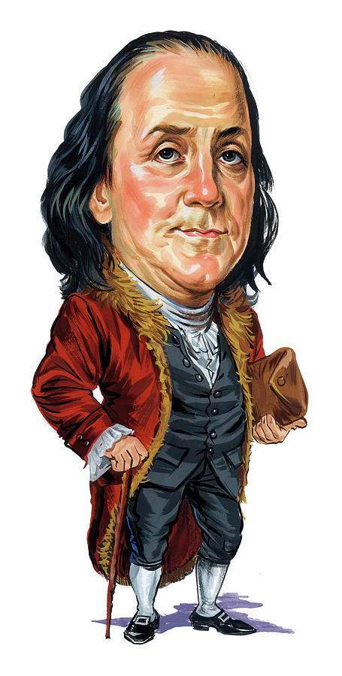
Regardless of grant maker affiliation...
“By failing to prepare,
you are preparing to fail.”
Benjamin Franklin

Slide 9
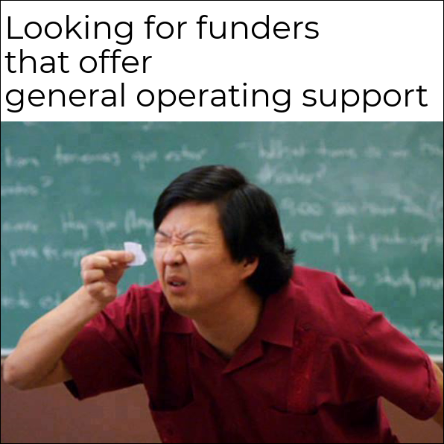
Private Grants Process
Do they have a website?
Look up their Form 990
Is this a good fit for your organization?
Integrate into your fundraising plan

Slide 10
Locating Private Grants
Google it!
Databases like
ProPublica and GuideStar.
Look at similar organizations for their sources of funding.

Slide 11
The Form 990 is Your Best Friend
Form 990 is the IRS' primary tool for gathering information about tax-exempt organizations.
Most private grant makers are a tax-exempt organization – meaning they must file this form each year.
Schedule I is required for organizations that make grants to others.

Slide 12
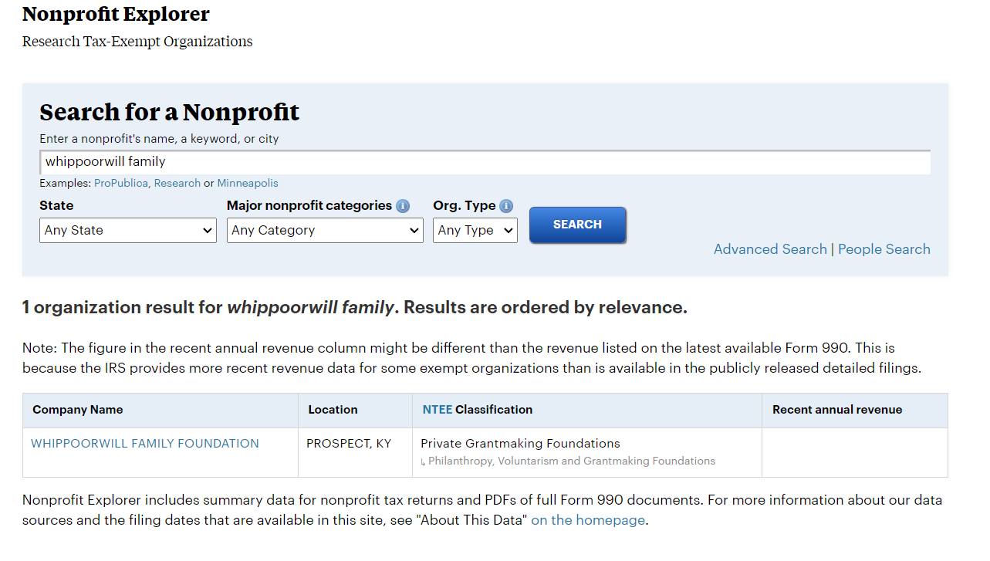
Example
https://projects.propublica.org/nonprofits/

Slide 13
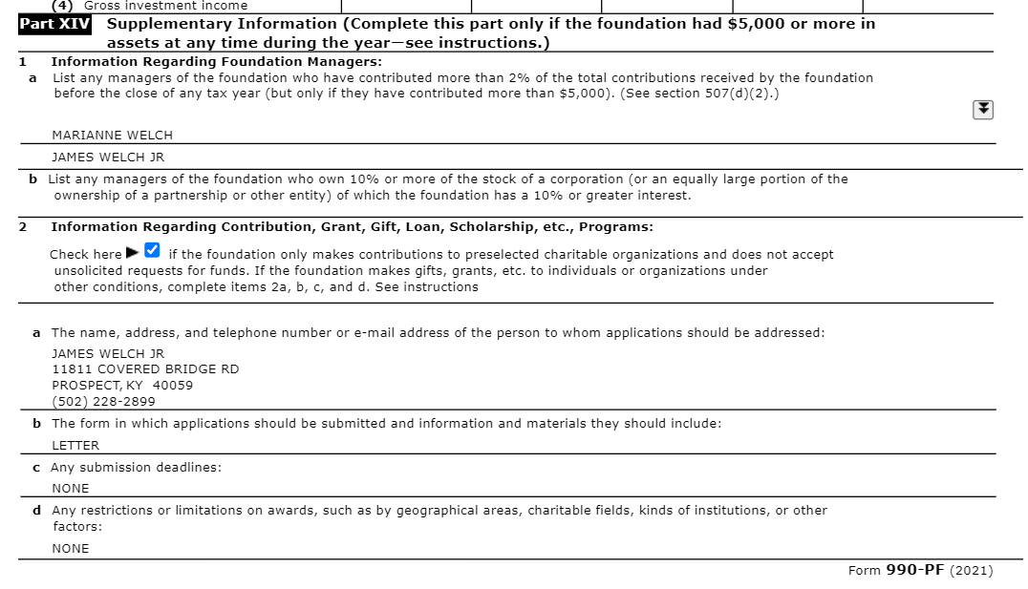
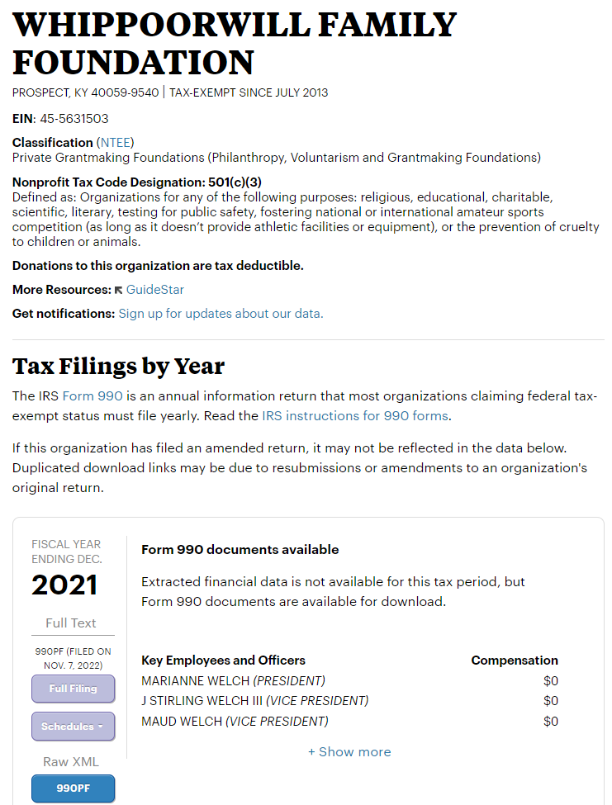
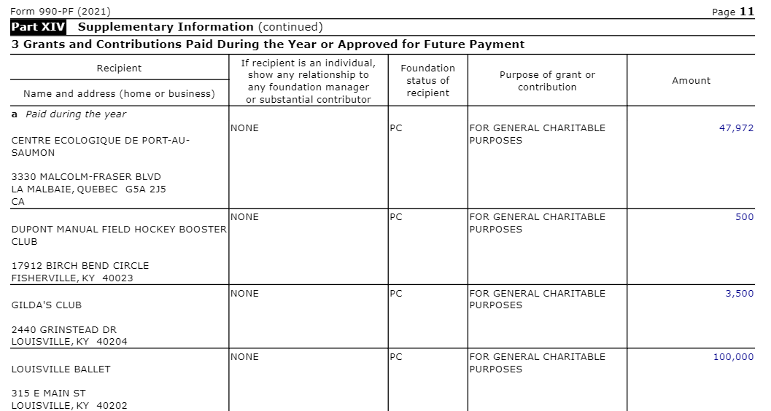
Looking at the Form 990

Slide 14
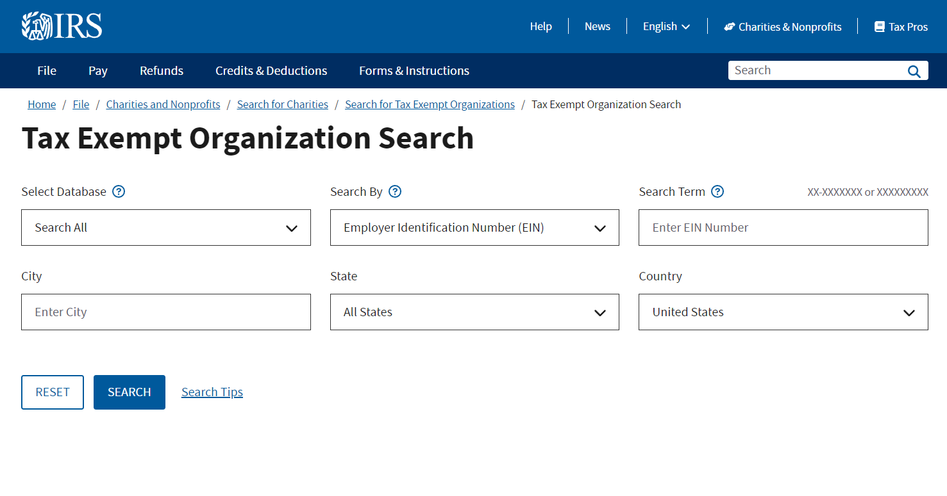
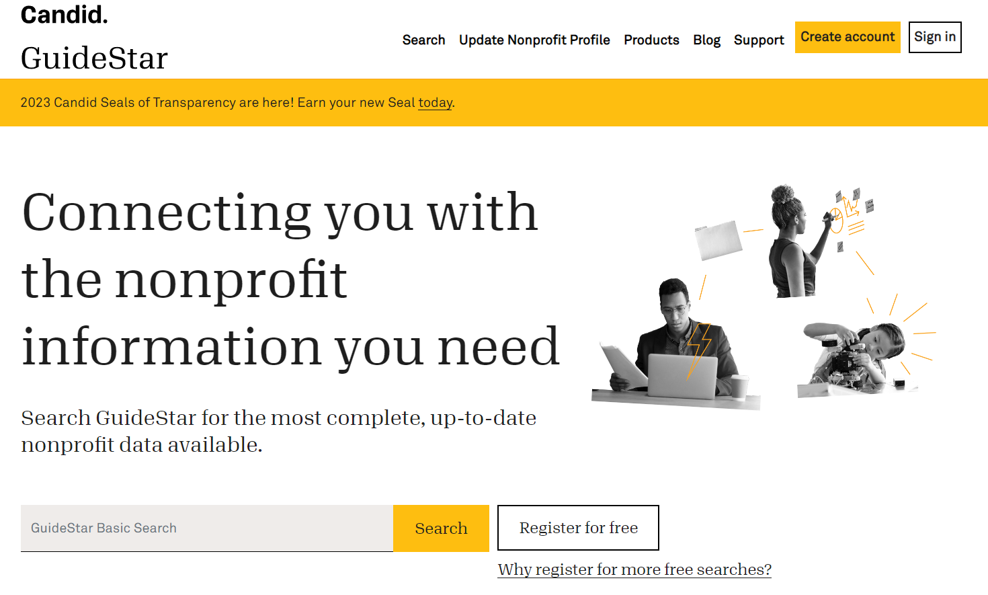
Additional Tools
IRS Tax Exempt Organization Search – check the legal and filing status of organizations. Especially good if you are approached by a foundation and want to check that they are a verified tax-exempt organization.
GuideStar – nonprofit database which includes additional filings such as annual reports, metrics, etc. Filing your own also distributes information to potential funders and gets you ‘GuideStar certified’.

Slide 15
Fundraising Plans
List your annual needs, including amounts and deadlines
List the grants you need to apply for, alphabetically or by due date
Include other fundraising aspects, such as crowdfunding campaigns, local sponsors, etc.

Slide 16
What information should you include?
Year of Plan and last edited
Current needs for year: Program title, date(s), $ needed, any other information or where information is located.
Table of potential funders and their information, sorted how it makes sense for you.

Slide 17
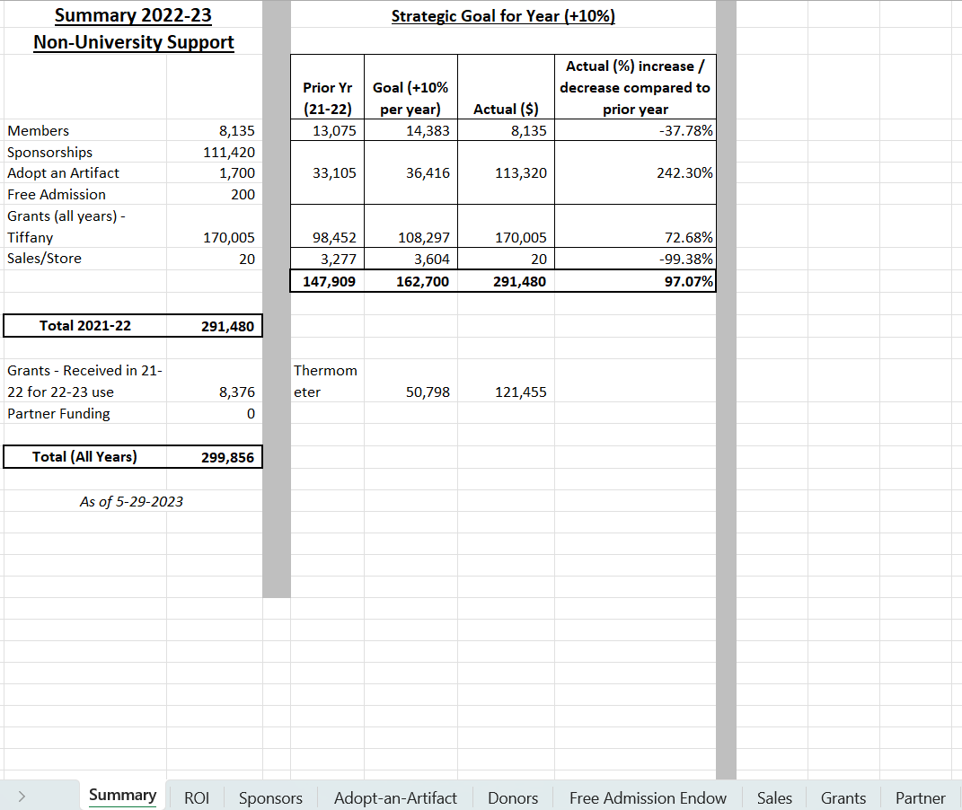
Tracking the Chaos in Excel
Goal taken directly from Strategic Plan. This chart allows us to see our targets and progress towards it overall and per program.
These auto-populate via link to tabbed sheets.
Excel offers an easy solution to track your fundraising programs on an annual basis, as well as comparing your year-to-year data. Let’s go through my workbook!
Each sheet tracks a specific fundraising program

Slide 18
Donors and Sponsors
Donors
- Column G totals to the “Members” line on the Summary sheet.
Received and Confirmed allow you to track when you have deposited the funds vs. when they appear on bank statements.
Campaign allows tracking renewal reminders, first-time members, monthly pledges, and special initiatives so you can see what is working and what is not.
Sponsors
Like Donors, but add Company, Proposal information, so can track if you have reached out but not heard back yet.

Slide 19
Grant Tracking
Lessons Learned
Color coding the rows helps quickly identify information.
Keep track of expected notification dates.
If the funder does not give one, use the last date of the year or March 31 of the following year, as these are the typical notification deadlines.
Not all funders will notify you – if you haven’t heard by year-end, it is probably a “no”.
Always write down the date you confirmed the received/denied. Really helps if you need to find the correspondence later!
Keeping track of what year the funds are allocated for is crucial as some boards or other funders will want to know this data. (We run on academic year cycle.)

Slide 20
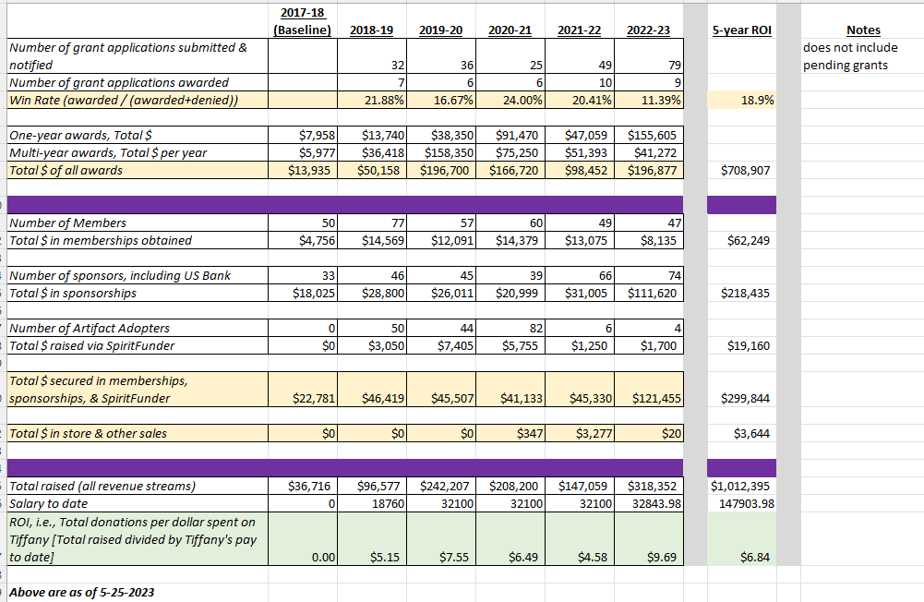
Metrics for Success
Establish your Baseline – typically the year you start keeping track, or the year before if you have data.
ROI = Return on Investment = the amount you raise versus the amount you are paid to do or the amount your organization spends on fundraising.
Win Rate = Amount of grants received vs. amount notified of decision.
These metrics are crucial for advocating for yourself! Remember: fundraising can’t happen without the “raiser.”

Slide 21
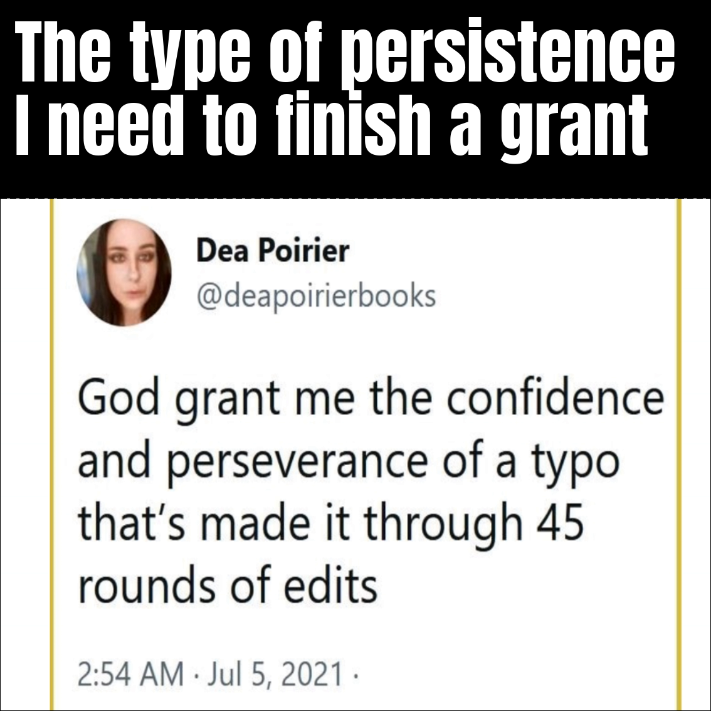
Thank you!
Tiffany Isselhardt
270-745-3369
tiffany.isselhardt@wku.edu
Kentucky Museum @ WKU

