Slide 1
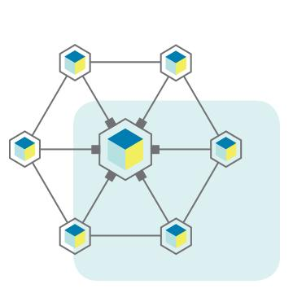
Building a Network and Wi-Fi Analytics
Connect
Analyze
Engage
Oscar Bross – Sr. Account Manager
513.608.0343
obross@powernetco.com
Notes:
Introduce and talk a bit about Powernet history, what we do.

Slide 2
25 years of experience in the telecom industry.
Headquartered in Cincinnati, Ohio.
24/7 U.S.-based NOC.
Dedicated account representatives.
Business, carrier and residential solutions for enterprise and SMB.
Woman-owned business
Powernet
enables businesses
and communities to connect through innovative voice, data, and wireless networking solutions.

Slide 3
The Benefits?
We will show you how to utilize your Wi-Fi network to:
Generate revenue.
Increase social media awareness.
Enhance your customer experience & engagement tools.
Gather data on visitors.
Deliver valuable content about your facility & daily events.
Create new targeted marketing campaigns.

Slide 4
Wi-Fi is now an expectation in public venues
Changing demographics:
A recent report revealed that the following are the most important things in life for young professionals:
Air
Water
Food
Internet (Wi-Fi)
Shelter
Enhanced client experience:
80% of people said accessible Wi-Fi in a venue contributes to a positive, personalized experience. (90% in age group 35-44)

Slide 5
Successful Wireless Clients

Slide 6
What is Intelligent Wi-Fi Software?
Identifies visitor demographics, social interests, visit history, and venue traffic patterns through a web-based portal (this is not an app).
Can be applied to an existing network as upgrade OR be put on a network that has been built from the ground up by Powernet.
Send Targeted messages and promotions directly to your users in real-time.

Slide 7
Customer Experience: Splash Page
Login Options
Facebook
Twitter
LinkedIn
Instagram
Form (custom)
Branding
Marketing Opportunities
Sponsor placement
Advertising space
Content can be changed as needed (daily, weekly, monthly).
Choose how to access our WiFi network
*HTML or Drag & Drop Layouts Available

Slide 8
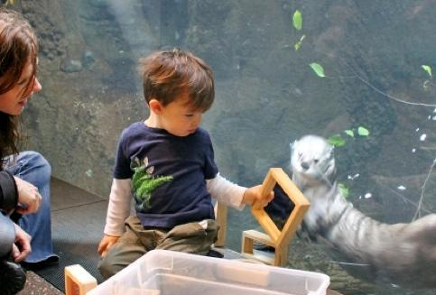
Customer Journey: Landing Page
Thanks, you are now online!
Google Custom Search
Search
Branding
Marketing
Showcase upcoming events.
Promote special offers.
Advertising space for partner/sponsor messages.
Optional features:
Social media feeds
Social media links
External website links
Content can be changed as needed (daily, weekly, monthly).
Events
Membership
Animals
Donate
*HTML or Drag & Drop Layouts Available

Slide 9
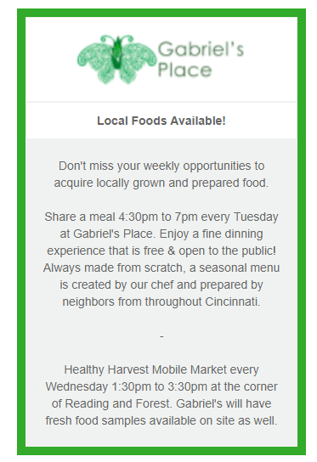
Engage with Visitors During and After Visit
SMS
E-shot
Email or text message users in real time
Share upcoming events, showtimes, discounts, or promotions
Educate visitors on exhibits and education
Campaign creation to send to users who meet certain criteria.
Returning visitor offers
Retention/re-engagement
The Lincoln Park Zoo: Thank you for your visit today and logging on to the free Wi-Fi. Visit
https://bbnc.lpzoo.org/page.aspx?pid=193 to learn more about how becoming a member saves you on future visits. Reply STOP to cancel.
From: Avondale
Subject: Share a meal with us!
*all recipients opt-in to receiving marketing/messages when logging into the Wi-Fi network.

Slide 10
Learning more about your visitors
Who your customers/visitors are?
Demographics?
Contact info?
Social interests?
How many times they have visited the facility?
Where they are at within the location?
How often do they visit?
What path do they take while there?

Slide 11
What information does Intelligent Wi-Fi collect?
What we collect:
Name
Age
Gender
Email
Phone number
Social interests
Location within network
What we do NOT collect:
Credit card information
Social login information
GPS location
Media files
Web search info/history
Contact lists

Slide 12
How is information collected & protected
All information is knowingly exchanged.
Users must accept Terms & Conditions.
Collected data is stored in a secure, online portal.
Information is available to approved users only.
User information is public information
Oscar Bross – Sr. Account Manager
513.608.0343
obross@powernetco.com

Slide 13
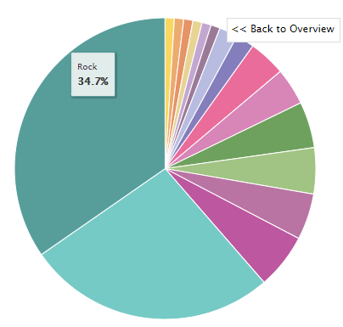
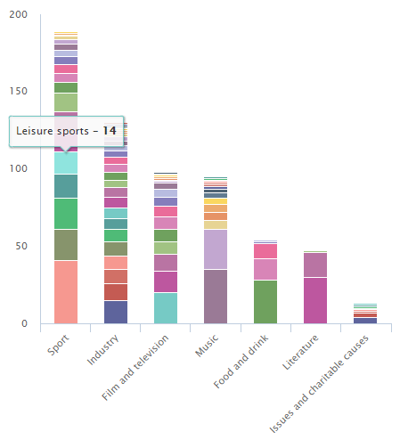
See Individual User Information
View in-depth user information.
Analyze user interests to determine proper advertisers & sponsors:
*Music by genre
*Personal information blacked out.

Slide 14
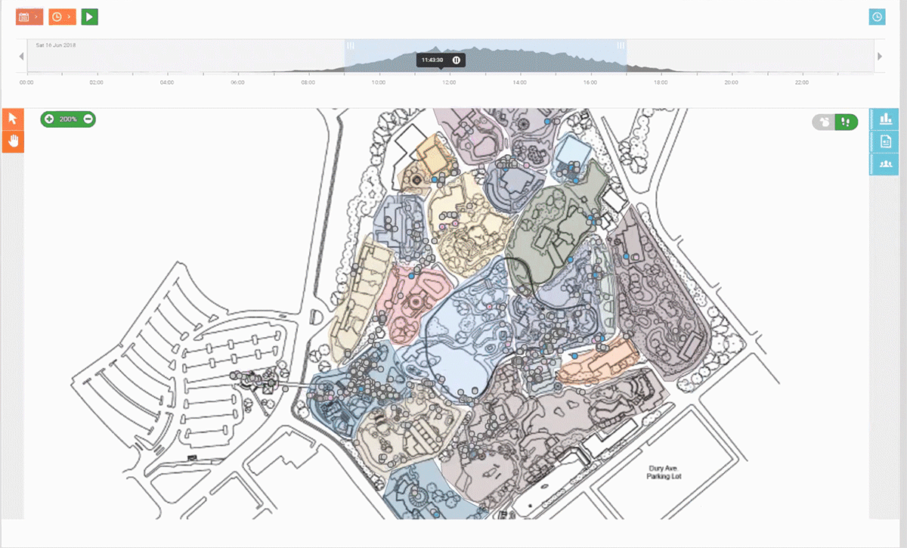
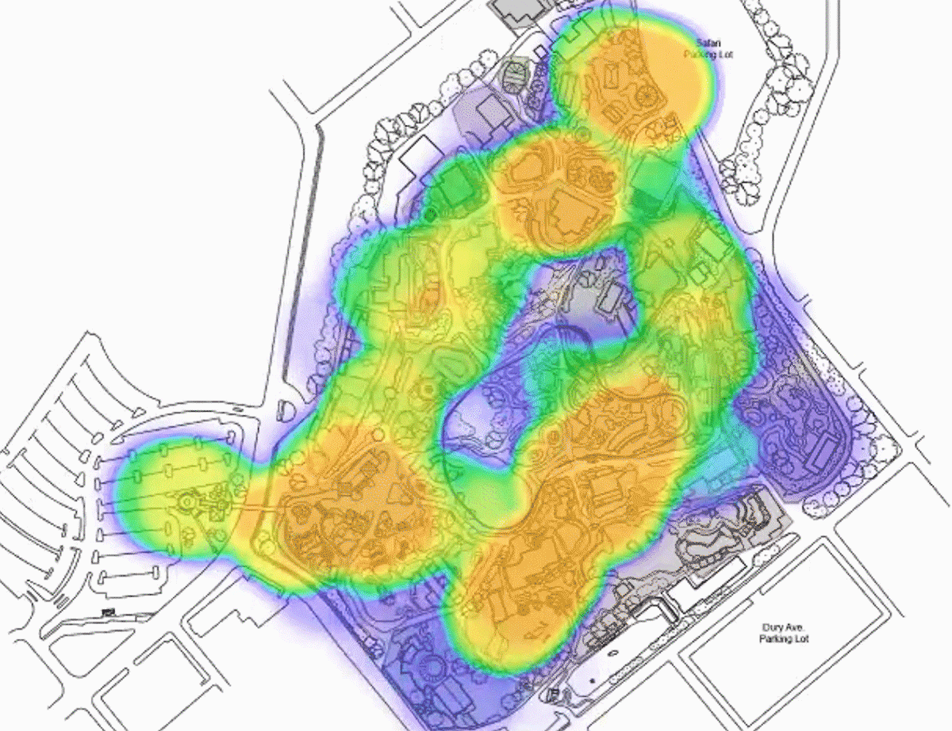
Location Services- ex. Cincinnati Zoo
Example heatmap:
Orange = high user density
Purple = low user density
Identify high traffic areas/low activity areas
View zone dwell time by specific parts of your venue

Slide 15
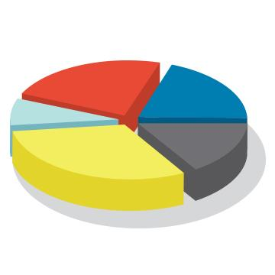
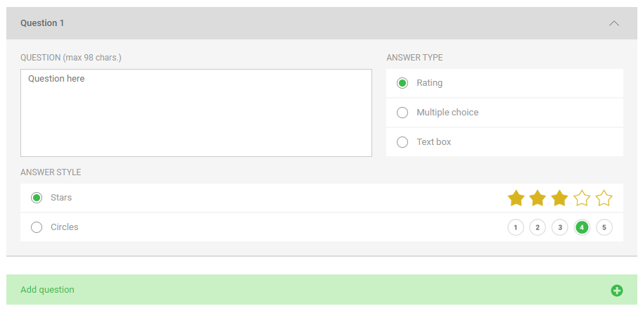
Create Visitor Surveys and See Results
Target surveys at specific events or create as needed.
Create rating, multiple choice, or open response questions.
See overall and individual responses.
Analyze simplified charts.

